Slide 1
Code retreat
www.mozaicworks.com

Slide 2
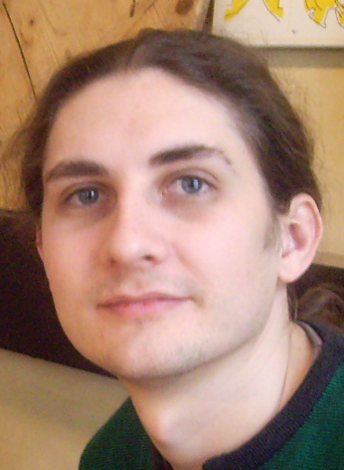
Me
Adi Bolboaca
Organizational & Technical
Trainer & Coach
www.mozaicworks.com

Slide 3

Me
Alex Bolboaca
Programmer, Trainer, Coach
www.mozaicworks.com

Slide 4
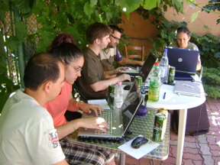
2009, First time outside US

Slide 5
Why?
Learn through pairing
Extend your comfort zone
Practice
Experiment
Learn new practices
www.mozaicworks.com

Slide 6
How?
1 day of coding
Choose a simple problem
6 pairing partners
On average 135 minutes of coding
6 different constraints
A lot of fun!
www.mozaicworks.com

Slide 7
How it started
CodeMash conference 2009
Gary Bernhardt
Patrick Welsh
Nayan Hajratwala
Corey Haines
www.mozaicworks.com

Slide 8
How it started
Repeatable
Day-long
Practice the fundamentals of programming
Intense day of coding
www.mozaicworks.com

Slide 9
Day structure
15' introduction
3 sessions of 45' coding + 15' retro&break
1h lunch
3 sessions of 45' coding + 15' retro&break
15' closing circle
www.mozaicworks.com

Slide 10
Principles
Language agnostic
Do not try to finish the problem
Delete the code after each session
Focus on practicing
Experiment each session
Have fun!
www.mozaicworks.com

Slide 11
How to take advantage
1. Embrace the freedom of deleting the code
2. Do what you always wanted but couldn't
3. Get out of your comfort zone
4. Pair with strangers in languages you don't know
5. What you learn is your responsibility

Slide 12
Prerequisites
Computer
Coding environment
Testing framework
Source control (git, svn, etc)
www.mozaicworks.com

Slide 13
The four elements of simple design
Passes its tests
Minimizes duplication
Maximizes clarity
Has fewer elements
www.mozaicworks.com

Slide 14
Conway's game of life
Having an infinite 2D orthogonal universe
Being given an initial generation called a seed
The following rules are applied simultaneously
A live cell having less than 2 live neighbors dies
A live cell having 2 or 3 live neighbors lives
A live cell having more than 3 neighbors dies
A dead cell having 3 neighbors becomes alive
www.mozaicworks.com

Slide 15
First session
Find a pair
Choose a programming language
Setup the environment
Choose an entry point for the problem
Start in 5 min
www.mozaicworks.com

Slide 16
Conway's game of life
Having an infinite 2D orthogonal universe
Being given an initial generation called a seed
The following rules are applied simultaneously
A live cell having less than 2 live neighbors dies
A live cell having 2 or 3 live neighbors lives
A live cell having more than 3 neighbors dies
A dead cell having 3 neighbors becomes alive
www.mozaicworks.com

Slide 17
Session constraints at your choice
No conditionals (if, while, etc)
No loops (for, foreach, while, etc)
Four lines of code per method
Use only one dot/arrow per line
www.mozaicworks.com

Slide 18
Taking Baby Steps
Initialize source control repository
Start a timer for 2 minutes
Write exactly one test
  Timer rings, the test is red, then revert and go to 2)
  The test is green before the timer rings, then commit
Restart timer
Refactor
  Timer rings, the refactoring is not complete then revert and restart
  The refactoring is complete before the timer rings, commit and go to 2)
Obs.
The timers must run continuously, don't stop to talk!
www.mozaicworks.com

Slide 19
Code retreat
1 hour Lunch
www.mozaicworks.com

Slide 20
TDD as if you meant it
Write exactly one failing test
Make the test pass by writing implementation code in the test method
Create a new implementation method by:
  Extracting implementation code to a new method in the test class
  Moving implementation code into an existing implementation method from the test class
Create implementation classes to provide a destination for extracting a method in the test class
When necessary move implementation methods into implementation classes
Refactor as required
www.mozaicworks.com

Slide 21
Tell don't ask
The internal state of a class is not accessible
A method call sends all the data needed to retrieve an answer
Each class computes the output using only its internal state
www.mozaicworks.com

Slide 22
Code retreat
Choose your own practice
Decide with your pair in the first 5 minutes
www.mozaicworks.com

Slide 23
Closing circle
How did you feel?
What did you learn today?
What will you do differently tomorrow?
www.mozaicworks.com

Slide 24
Code retreat
Why?
Learn through pairing
Extend your comfort zone
Practice
Experiment
Learn new practices
www.mozaicworks.com

Slide 25
Contact me
Remote pair-programming
Unit testing workshop
Test driven development workshop
Clean code workshop
Refactoring workshop
Legacy code retreat
Working FAST and Safe with existing code
Code retreat
www.mozaicworks.com

Slide 26
Contact me
Remote pair-programming
Unit testing workshop
Test driven development workshop
Clean code workshop
Refactoring workshop
Legacy code retreat
Working FAST and Safe with existing code
Code retreat
www.mozaicworks.com

Slide 27




Code retreat
Extend your mentoring & training capacity
Accelerate learning through communities of practice
Grow your functional leaders and top talents
  http://www.mozaicworks.com
  adrian.bolboaca@mozaicworks.com
  @adibolb

